Slide 1
Radiation
Prepared by:
Prof.Reena Makadia
Department Of Mechanical Engineering,
LE COLLEGE,MORBI

Slide 2
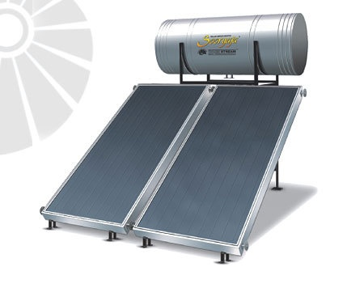
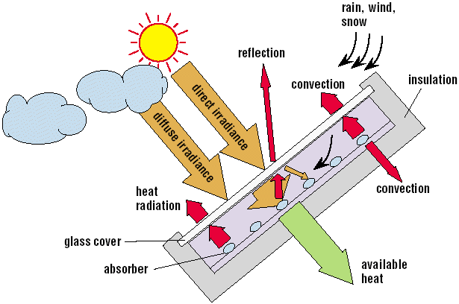
Flat Plate Solar Water Heater

Slide 3
Contents…..
Fundamental Concepts
Radiation Terminologies
Laws Of Radiation
Heat Exchange between the surfaces(Black and Non Black Surfaces)
Problems

Slide 4
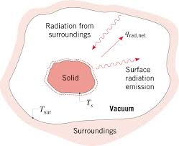
Thermal Radiation
Any matter with temperature above absolute zero (0 K) emits electromagnetic radiation.

Slide 5
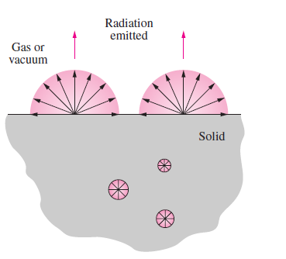
Surface and Volumetric Phenomenon

Slide 6
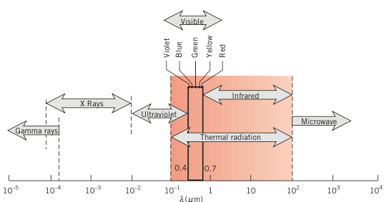
Spectrum of Electromagnetic Radiation

Slide 7
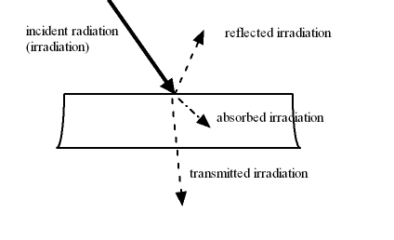
Irradiation Of Surface, G
Total Radiant energy received by per unit time per unit area from all directions at all wavelength.
It is not a surface property…….

Slide 9
Types Of Surface
Black Surface, ρ and  = 0 and  =1
Opaque Surface,  = 0 and  + ρ =1
White Surface,  =0,  = 0 , ρ =1
Grey Surface,  = 
Transparent Surface,  =0 , ρ = 0 ,  = 1

Slide 10
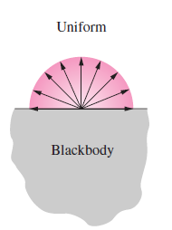
Emission Characteristics of Surfaces
Total Hemispherical Emissive Power (e):
Radiant flux emitted from a surface of a body(W/m²)
Total Hemispherical Emissive Power of a black surface is denoted by e_{b}

Slide 11
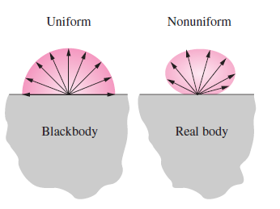
Total Hemispherical Emissivity(ε)
Diffuse Emitter

Slide 12
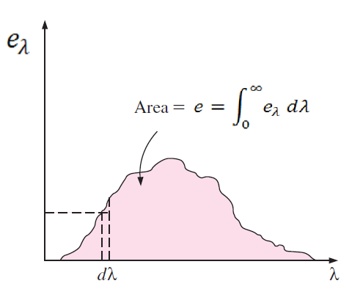
Monochromatic (Spectral)Hemispherical
Emissive Power (e_{λ})
Radiant flux emitted by unit wavelength, W/m²⁻μm
Or

Slide 13
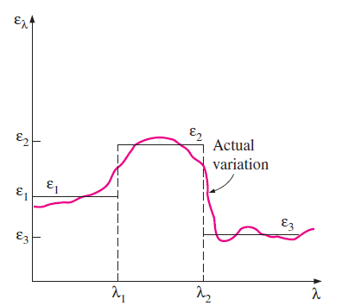
Monochromatic (Spectral)Hemispherical
Emissivity (ε_{λ})

Slide 14
Laws Of Radiation
Planck’s Law
Wein’s Law
Stefan Boltsmann’s Law
Kirchoff’s Law

Slide 15
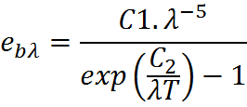
Planck’s Law for Spectral Distribution
W/(m² μm)
C₁=3.742 X 10⁸ Wμm⁴/m²
C₂ =1.4387 X 10⁴ μmK.

Slide 16
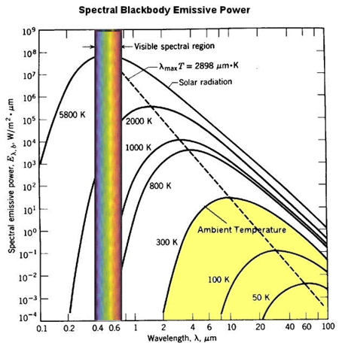

Slide 17
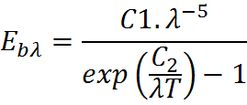
Wien's Displacement Law

Slide 18
Stefan Boltsmann’s Law
σ = 5.67 X 10⁻⁸ W/m²K⁴

Slide 19
Temperature of sun surface is 5779 K. Surface may be assumed to be black surface .
Calculate the values of λ_{m} ,e_{bλ=λm ,}e_{b} on the sun’s surface. Also determine e_{bλ=λm ,}e_{b} as received at earth surface.
Take distance between Sun and Earth is =1.496 x10⁸ km
Radius of the sun is 0.695 x106 km

Slide 20
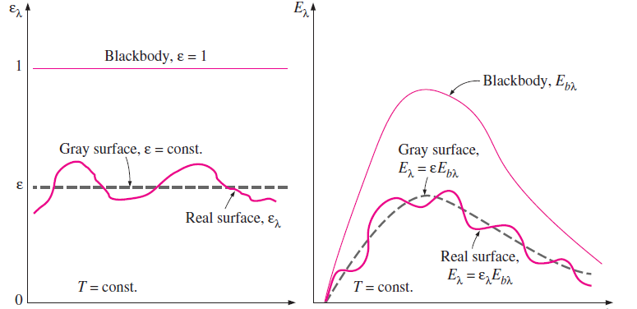
Emissivity Of Real and Grey Surface

Slide 21
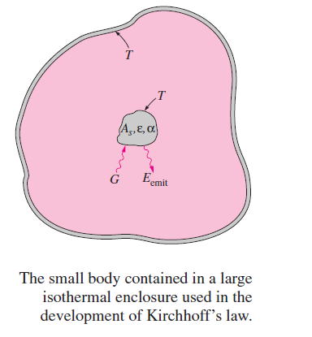
Kirchhoff’s Law

Slide 22
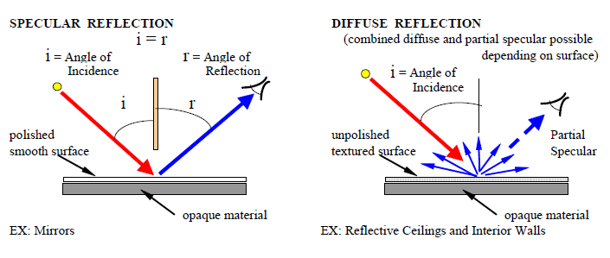

Slide 23
Total Hemispherical Emissive Power
Temperature
Kelvin ,
K
Wavelength,
λ
Direction
Solid Angle,
ω
Spectral
Emissive Power
Monochromatic Emissive power
Radiation Intensity

Slide 24
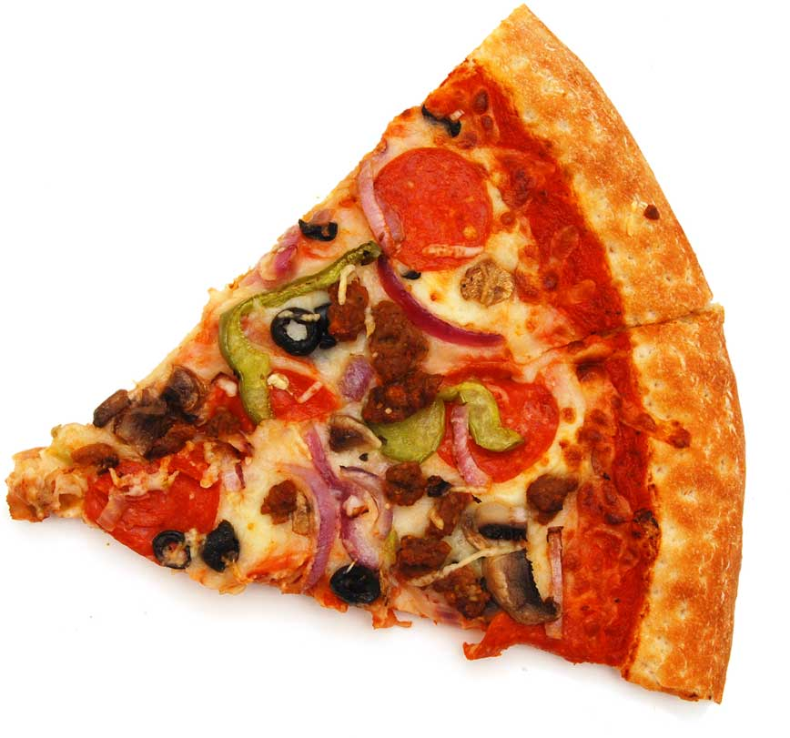
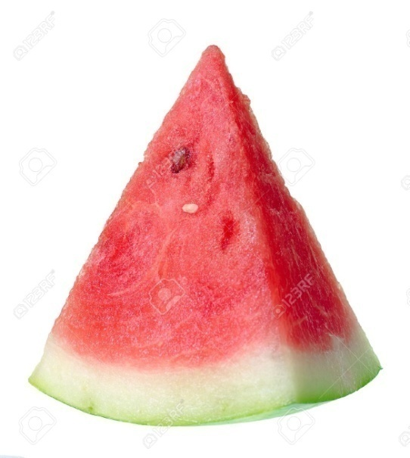
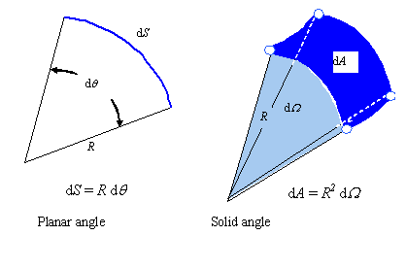
dω
dω

Slide 25
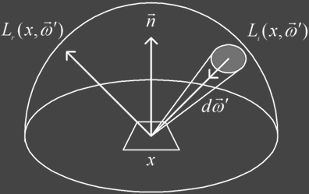
Solid Angle
Region Of sphere ,which is enclosed by a conical surface with the vertex of the cone at the centre of the sphere.
dA_{n}
dA₁

Slide 26
Intensity Of Radiation

Slide 27
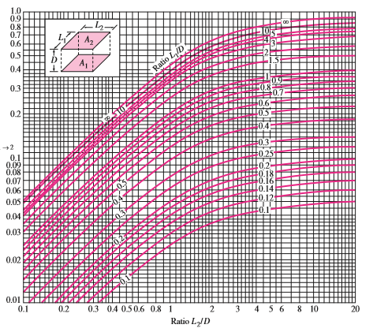

Slide 28
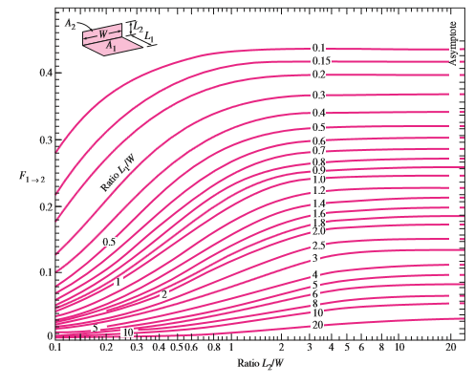

Slide 29
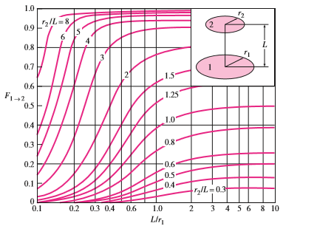

Slide 30
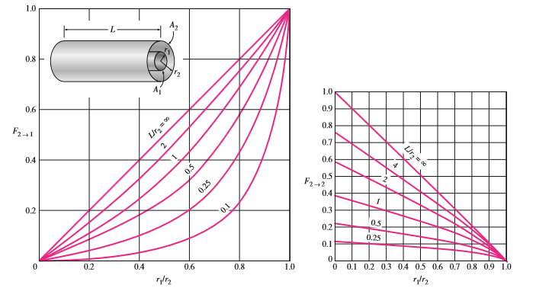

Slide 31
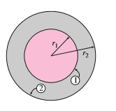
r₁=3m and r₂ =6m
Calculate associated View Factors.

Slide 32
A Furnace cavity, which in form of cylinder of 75mm diameter and 150 mm length is open at one end to large surroundings that are at 27˚C. The sides and bottom may be black surface and well insulated and maintained at 1350˚C and 1650˚C respectively. How much power is required to maintain the furnace temperature.

