Slide 1
Overview of Probability

Slide 2
Contents
Importance of Statistical tools in Machine Learning
Concepts of probability
Random variables
Discrete distributions
Continuous distributions
Multiple random variables
Central limit theorem
Sampling distributions
Hypothesis testing
Monte Carlo Approximation

Slide 3
INTRODUCTION
Machine learning provides us a set of methods that can automatically detect patterns in data, and then can be used to uncover patterns to predict future data, or to perform other kinds of decision making under uncertainty.
The best way to perform such activities on top of huge data set known as big data is to use the tools of probability theory because probability theory can be applied to any situation involving uncertainty.
We will discuss the tools, equations, and models of probability that are useful for machine learning domain

Slide 4
IMPORTANCE OF STATISTICAL TOOLS IN MACHINE LEARNING
In machine learning, we train the system by using a limited data set called ‘training data’ and based on the confidence level of the training data we expect the machine learning algorithm to depict the behaviour of the larger set of actual data.
If we have observation on a subset of events, called ‘sample’, then there will be some uncertainty in attributing the sample results to the whole set or population.
So, the question was how a limited knowledge of a sample set can be used to predict the behaviour of a real set.
It was realized by mathematicians that even if some knowledge is based on a sample, if we know the amount of uncertainty related to it, then it can be used in an optimum way.
Probability theory provides a mathematical foundation for quantifying this uncertainty of the knowledge.

Slide 6
Concepts of probability
In our day to day life, we use the concept of probability in many places.
Ex. when a coin is flipped.
This is the frequentist interpretation of probability.
Another important interpretation of probability tries to quantify the uncertainty of some event and thus focuses on information rather than repeated trials. This is called the Bayesian interpretation of probability.
Ex. compute the probability of India winning 2022 cricket world cup final.

Slide 7
basic rules
p(A) : the probability that the event A is true
Ex. India winning 2022 cricket world cup final.
0 ≤ p(A) ≤ 1 : probability of this event happening lies between 0 and 1.
p(A) = 0 : the event will definitely not happen.
p(A) = 1: the event will definitely happen.
p(A̅) : the probability of the event not A.
p(A̅) = 1 − p(A).
The probability o f selecting an event A, from a sample size of X is defined as :
p(A) = n/X
where n is the number of times the instance of event A is present in the sample of size X.

Slide 8
Probability of a union of two events
Two events A and B are called mutually exclusive if they can’t happen together.
For example, India winning the cricket World Cup 2022 and England winning the cricket World Cup 2022 are two mutually exclusive events.

Slide 11
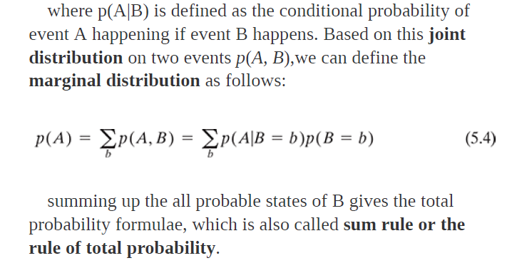

Slide 13
Conditional probability

Slide 14
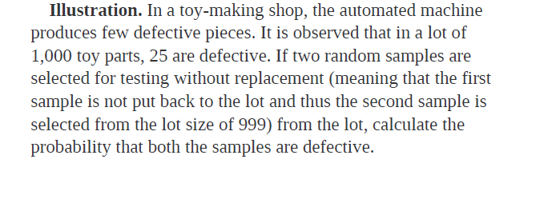

Slide 15
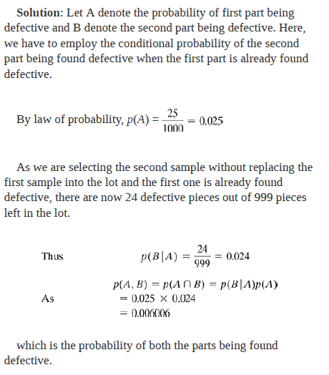

Slide 16
RANDOM VARIABLES

Slide 17
RANDOM VARIABLES
In probability and statistics, random variable, random quantity or stochastic variable is a variable whose possible values are the outcomes of a random phenomenon.
It’s a function which performs the mapping of the outcomes of a random process to a numeric value.
Random variables makes our task much easier to quantify results of any random process and apply math and perform further computation.

Slide 18
Random variables allows us to ask questions in mathematical way.
If we flip 5 coins and want to answers questions like:
1. What is the probability of getting exactly 3 heads?
2. What is the probability of getting less than 4 heads?
Then our general way of writing would be:
· P(Probability of getting exactly 3 heads when we flip a coin 5 times)
· P(Probability of getting less than 4 heads when we flip a coin 5 times)
But if we use random variables to represent above questions then we would write:
1. P(X=3)
2. P(X<4)

Slide 19
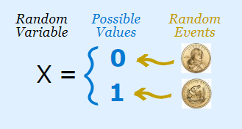
Suppose we have a random process/experiment of flipping a coin. One of the two possible outcomes could be either a head or a tail. So here we use X to denote random variable, which represents the outcomes of the this random process.
Therefore we can write
X= 1, if the outcome is head
X= 0, if the outcome is tail
Here the random Variable X is mapping the outcomes of the random process(flipping a coin) to the numerical values (1 and 0).

Slide 20
Summarizing in three points
We have an experiment(tossing a coin)
We give values to each event
These set of values is a random variable.
If random variable X={0,1,2,3}
Then X could be 0, 1, 2 or 3 randomly where each of them might have a different probability.

Slide 21
Discrete random variables
Let X be a random variable and it changes values only in jumps (a countable number of them) and remains constant between the jumps it is called a discrete random variable.
A discrete random variable has a countable number of possible values.
The probability of each value of a discrete random variable is between 0 and 1, and the sum of all the probabilities is equal to 1.
Probability mass function (PMF) is a function that relates discrete events to the probabilities associated with those events occurring.
PMF is a probability measure that gives us probabilities of the possible values for a random variable.

Slide 22
Let X be a discrete random variable with range R_{X}={x1,x2,x3,...} .
The function
P_{X}(x_{k}) = P(X=x_{k}), for k=1,2,3,...,
is called the probability mass function (PMF) of X.

Slide 24
Continuous random variables
A continuous random variable is a random variable where the data can take infinitely many values.
Most of the real-life events are continuous in nature. For example, if we have to measure the actual time taken to finish an activity then there can be an infinite number of possible ways to complete the activity.
Thus the measurement is continuous and not discrete as it is not similar to the discrete event of rolling a dice or flipping a coin.
The Probability density function (pdf) is used to specify the probability of the random variable falling within a particular range of values, as opposed to taking on any one value.

Slide 25
the PDF is used to specify the probability of the random variable falling within a particular range of values, as opposed to taking on any one value.

Slide 27
The cumulative distribution function (CDF) of a random variable is another method to describe the distribution of random variables.
The advantage of the cdf is that it can be defined for any kind of random variable (discrete, continuous).
The cumulative distribution function (cdf) of a real-valued random variable X, or just distribution function of X, evaluated at x is the probability that X will take a value less than or equal to x
The cumulative distribution function (CDF) of random variable X is defined as
F_{x}(x)=p(X≤x)

Slide 29
Mean and variance
The mean in statistical terms represents the weighted average of the all the possible values of random variable X and each value is weighted by its probability.
It is denoted by µ or E(X).
Variance of a random variable X measures the spread or dispersion of X.

Slide 31
DISCRETE DISTRIBUTIONS

Slide 32
Bernoulli distributions
The bernoulli distribution is the discrete probability distribution of a random variable which takes a binary, boolean output: 1 with probability p, and 0 with probability (1-p).
Whenever you are running an experiment which might lead either to a success or to a failure, you can associate with your success (labeled with 1) a probability p, while your insuccess (labeled with 0) will have probability (1-p).

Slide 33
Imagine your experiment consists of flipping a coin and you will win if the output is tail. Furthermore, since the coin is fair, you know that the probability of having tail is p=1/2. Hence, once set tail=1 and head=0, you can compute the probability of success as follows:
Imagine your experiment consists of flipping a coin and you will win if the output is tail. Furthermore, since the coin is fair, you know that the probability of having tail is p=1/2. Hence, once set tail=1 and head=0, you can compute the probability of success as follows:
P(X=1) = f(1) = P = ½
Again, imagine you are about to toss a dice, and you bet your money on the number 1: hence, number 1 will be your success (labeled with 1), while any other number will be a failure (labeled with 0). The probability of success is 1/6. If you want to compute the probability of failure, you will do like so:
P(X=0) = f(0) = 1- P = 5/6

Slide 34
Binomial distribution
A binomial distribution can be thought of as simply the probability of a SUCCESS or FAILURE outcome in an experiment or survey that is repeated multiple times.
The binomial is a type of distribution that has two possible outcomes
For example,
A coin toss has only two possible outcomes: heads or tails
Taking a test could have two possible outcomes: pass or fail.
If n independent bernoulli trials are performed and x represents the number of success in those n trials, then x is called a binomial random variable.

Slide 35
Bernoulli random variable is a special case of binomial random variable with parameters (1, p).
The first variable in the binomial formula, n, stands for the number of times the experiment runs.
The second variable, p, represents the probability of one specific outcome.
For example, let’s suppose you wanted to know the probability of getting a 1 on a die roll. if you were to roll a die 20 times, the probability of rolling a one on any throw is 1/6. Roll twenty times and you have a binomial distribution of (n=20, p=1/6).

Slide 36
The binomial distribution formula is:
b(x; n, P) = _{n}C_{x} * P^{x} * (1 – P)^{n – x}
Where: b = binomial probability x = total number of “successes” (pass or fail, heads or tails etc.) P = probability of a success on an individual trial n = number of trials
_{n}C_{x} = n! / x!(n – x)!

Slide 37
The multinomial and multinoulli distributions
The Multinoulli distribution, also called the categorical distribution, covers the case where an event will have one of K possible outcomes.
x in {1, 2, 3, …, K}
It is a generalization of the Bernoulli distribution from a binary variable to a categorical variable, where the number of cases K for the Bernoulli distribution is set to 2, K=2.
A common example that follows a Multinoulli distribution is:
A single roll of a die that will have an outcome in {1, 2, 3, 4, 5, 6}, e.g. K=6.

Slide 38
The probability (pmf) of a certain outcome can be modeled using the formula:
p(X=k)= (n! /x1! * x2! * …* xk!) p1^{x1}⋅p2^{x2}…pk^{xk}
Where
n is the number of trials,
xi is the number of times event i occurs and
pi is the probability of event i at each independent trial.
As an example, consider a problem which can take 3 outcomes at each trial. The probability of obtaining one specific outcomes can be written as:
p(X=k)= (n! / (x1!* x2! * x3!) p1^{x1}⋅p2^{x2}⋅p3^{x3}

Slide 39
The repetition of multiple independent Multinoulli trials will follow a multinomial distribution.
The multinomial distribution is a generalization of the binomial distribution for a discrete variable with K outcomes.
An example of a multinomial process includes a sequence of independent dice rolls.
A common example of the multinomial distribution is the occurrence counts of words in a text document, from the field of natural language processing.
A multinomial distribution is summarized by a discrete random variable with K outcomes, a probability for each outcome from p1 to pK, and k successive trials.

Slide 40
The multinomial distribution applies to experiments in which the following conditions are true:
The experiment consists of repeated trials, such as rolling a dice five times instead of just once.
Each trial must be independent of the others. For example, if you roll two dice, the outcome of one dice does not impact the outcome of the other dice.
The probability of each outcome must be the same across each instance of the experiment. For example, if a dice has six sides, then there must be a one in six chance of each number being given on each roll.
Each trial must produce a specific outcome, such as a number between two and 12 if rolling two six-sided dice.

Slide 41
Poisson distribution
A Poisson distribution is a tool that helps to predict the probability of certain events happening when you know how often the event has occurred. It gives us the probability of a given number of events happening in a fixed interval of time.
So, a Poisson distribution can be used to measure how many times an event is likely to occur within "X" period of time
A textbook store rents an average of 200 books every Saturday night. Using this data, you can predict the probability that more books will sell (perhaps 300 or 400) on the following Saturday nights.
Another example is the number of diners in a certain restaurant every day. If the average number of diners for seven days is 500, you can predict the probability of a certain day having more customers.

Slide 42
The Poisson Distribution pmf is:
P(x; μ) = (e^{-μ} * μ^{x}) / x!
μ (the expected number of occurrences) is sometimes written as λ. Sometimes called the event rate or rate parameter.
The average number of major storms in your city is 2 per year. What is the probability that exactly 3 storms will hit your city next year?
Step 1: Figure out the components you need to put into the equation.
μ = 2 (average number of storms per year, historically)
x = 3 (the number of storms we think might hit next year)
e = 2.71828 (e is Euler’s number, a constant)
Step 2: Plug the values from Step 1 into the Poisson distribution formula:
P(x; μ) = (e^{-μ}) (μ^{x}) / x!
= (2.71828 ^{– 2}) (2³) / 3!
= (0.13534) (8) / 6
= 0.180

Slide 43
CONTINUOUS DISTRIBUTIONS

Slide 44
Uniform distribution
Uniform distribution refers to a type of probability distribution in which all outcomes are equally likely.
In a continuous uniform distribution, outcomes are continuous and infinite.
An idealized random number generator would be considered a continuous uniform distribution. With this type of distribution, every point in the continuous range between 0.0 and 1.0 has an equal opportunity of appearing, yet there is an infinite number of points between 0.0 and 1.0.

Slide 46
Example :
You arrive into a building and are about to take an elevator to the your floor. Once you call the elevator, it will take between 0 and 40 seconds to arrive to you. In this case a = 0 and b = 40.

Slide 47
Gaussian (normal) distribution
The most widely used distribution in statistics and machine learning is the Gaussian or normal distribution.
Gaussian distribution, is a probability distribution that is symmetric about the mean, showing that data near the mean are more frequent in occurrence than data far from the mean. In graph form, normal distribution will appear as a bell curve.

Slide 48
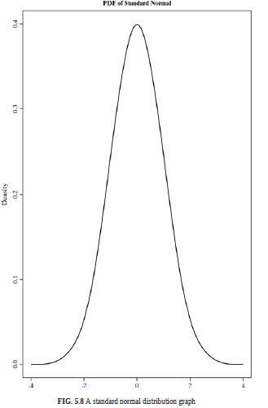

Slide 49
The laplace distribution
Like the normal distribution, this distribution is unimodal (one peak) and it is also a symmetrical distribution. However, it has a sharper peak than the normal distribution.
The Laplace distribution is the distribution of the difference of two independent random variables with identical exponential distributions. It is often used to model phenomena when data has a higher peak than the normal distribution.
This distribution is the result of two exponential distributions, one positive and one negative; It is sometimes called the double exponential distribution, because it looks like two exponential distributions spliced together back-to-back.

Slide 51
MULTIPLE RANDOM VARIABLES

Slide 52
Bivariate random variables
Let us consider two random variables X and Y in the sample space of S of a random experiment. Then the pair (X, Y) is called s bivariate random variable or two-dimensional random vector where each of X and Y are associated with a real number for every element of S.
(X, Y) is called a discrete bivariate random variable
if the random variables X and Y both by themselves are discrete.
(X, Y) is called a continuous bivariate random variable
if the random variables X and Y both are continuous
mixed bivariate random variable
if one of X and Y is discrete and the other is continuous.

Slide 53
Cont..
Joint distribution functions
The joint cumulative distribution function (or joint cdf) of X and Y is defined as:
F_{XY} (x,y) = P (X<= x, Y <= y)

Slide 55
If continuous random variables X and Y are defined on the same sample space S, then their joint probability density function (joint pdf) is denoted f(x,y), that satisfies the following.
P((X,Y)∈A)=∬_{A}f(x,y)dxdy

Slide 56
Covariance and correlation

Slide 57
Covariance and correlation
The covariance between two random variables X and Y measure the degree to which X and Y are (linearly) related, which means how X varies with Y and vice versa.
Cov(X,Y) = E(XY) – E(X) E(Y)
variance is the measure of how a random variable varies with itself, then the covariance is the measure of how two random variables vary with each other.
If Cov (X,Y) = 0, then we can say X and Y are uncorrelated.
Covariance can be between 0 and infinity. Sometimes, it is more convenient to work with a normalized measure.

Slide 59
CENTRAL LIMIT THEOREM

Slide 60
CENTRAL LIMIT THEOREM
In probability theory, the central limit theorem (CLT) states that the distribution of a sample variable approximates a normal distribution (i.e., a “bell curve”) as the sample size becomes larger.
given a sufficiently large sample size from a population with a finite level of variance, the mean of all sampled variables from the same population will be approximately equal to the mean of the population.
A key aspect of CLT is that the average of the sample means and standard deviations will equal the population mean and standard deviation.

Slide 62
SAMPLING DISTRIBUTIONS

Slide 63
The key component of machine learning is to use a sample- based training data which can be used to represent the larger set of actual data and it is important to estimate how confidently an outcome can be related to the behaviour of the training data so that the decisions on the actual data can be made
Population is a finite set of objects being investigated.
Random sample refers to a sample of objects drawn from a population in a way that every member of the population has the same chance of being chosen.
Sampling distribution refers to the probability distribution of a random variable defined in a space of random samples.

Slide 64
Sampling with replacement
While choosing the samples from the population if each object chosen is returned to the population before the next object is chosen, then it is called the sampling with replacement.
In this case, repetitions are allowed.
That means, if the sample size n is chosen from the population size of N, then
the number of such samples is = N^{n} , because each object can be repeated.
Also, the probability of each sample being chosen is the same and is 1/ N^{n}

Slide 66
For example,
let’s choose a random sample of 2 patients from a population of 3 patients {A, B, C} and replacement is allowed. There can be 9 such ordered pairs, like:
(A, A), (A, B), (A, C), (B, A), (B, B), (B, C), (C, A), (C, B), (C, C)
That means the number of random samples of 2 from the population of 3 is
N^{n} = 3 ²= 9
and each of the random sample has probability of 1/9 being chosen.

Slide 67
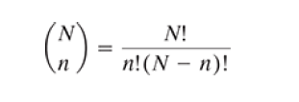
Sampling without replacement
In case, we don’t return the object being chosen to the population before choosing the next object, then the random sample of size n is defined as the unordered subset of n objects from the population and called sampling without replacement.
The number of such samples that can be drawn from the population size of N is:

Slide 68
In our previous example, the unordered sample of 2 that can be created from the population of 3 patients when replacement is not allowed is
(A, B), (A, C), (B, C)

Slide 70
HYPOTHESIS TESTING

Slide 71
While dealing with random variables a common situation is when we have to make certain decisions or choices based on the observations or data which are random in nature.
The solutions for dealing with these situations is called decision theory or hypothesis testing.
In terms of statistics, a hypothesis is an assumption about the probability law of the random variables.
Hypothesis Testing is basically an assumption that we make about the population parameter. Ex : you say avg student in class is 40 or a boy is taller than girls.

Slide 72
A hypothesis test evaluates two mutually exclusive statements about a population to determine which statement is best supported by the sample data.
Null hypothesis :- In inferential statistics, the null hypothesis is a general statement or default position that there is no relationship between two measured phenomena, or no association among groups.
The alternative hypothesis is the hypothesis used in hypothesis testing that is contrary to the null hypothesis.

Slide 73
Example : you have a coin and you don’t know whether that is fair or tricky so let’s decide null and alternate hypothesis
H0 : a coin is a fair coin.
H1 : a coin is a tricky coin.
Level of significance: Refers to the degree of significance in which we accept or reject the hypothesis.
This is normally denoted with alpha(maths symbol ) and generally it is 0.05 or 5% , which means your output should be 95% confident to give similar kind of result in each sample.

Slide 74
There are 4 possible decisions:
1.H0 is true; accept H0 ➔ this is a correct decision
2. H0 is true; reject H0 (which means accept H1 ) ➔ this is an incorrect decision
3. H1 is true; accept H1 ➔ this is a correct decision
4. H1 is true; reject H1 (which means accept H0 ) ➔ this is an incorrect decision.

Slide 75
So, we can see there is the possibility of 2 correct and 2 incorrect decisions and the corresponding actions. The erroneous decisions can be termed as:
Type I error: reject H0 (or accept H1 ) when H0 is true. This is also called Alpha error where good is interpreted as bad.
Type II error: reject H1 (or accept H0 ) when H1 is true. This is also called Beta error where bad is interpreted as good and can have a more devastating impact.

