Slide 1
FLUID MECHANICS and HEAT TRANSFER (FMHT)
L. E. College, Morbi-2
Industrial Engineering Department
Chapter-07– Conduction
Prepared by Prof. Divyesh B. Patel
Mechanical Engg. Dept
LE. College, Morbi
+919925282644
divyesh21dragon@gmail.com

Slide 2
One dimensional steady state conduction,
y
T = T(r, θ,z,t)
θ
q_{g} = q_{g} (r, θ,z,t)
Point fuction
r
0
0
0
x
z
Steady state, and 1-Dimension,
T = T(r)
q_{g} = q_{g} (r)
K = K (T)
0
Steady state, 1-Dimension, Thermal conductivity is constant and no heat generated

Slide 3
One-dimensional heat flow through a hollow cylinder,
L
L >> r
Integrating with respect to r
T_{h}>T_{c}
Again integrating with respect to r
r₁
T_{c}
T_{h}
Applying boundary Condition
T
r = r₁ , T= T_{h}
T_{h} = C₁ ln r₁ + C₂
r
r₂
r = r₂ , T= T_{c}
T_{c} = C₁ ln r₂ + C₂
C₁ = (T_{h} –T_{c})/(ln(r₁/ r₂))

Slide 4
One-dimensional heat flow through a hollow cylinder,
Δr
Q _{r +Δr}
r₁
r
Q _{r}
r₂
Where

Slide 5
One-dimensional heat flow through a hollow cylinder,

Slide 6
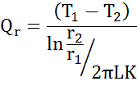
One-dimensional heat flow through a hollow cylinder,
T₁ > T₂
Q
T₁
R_{conduction}
T₂

Slide 7
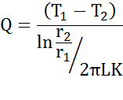
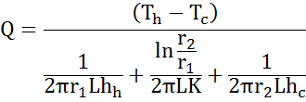
One-dimensional heat flow through a hollow cylinder,
T_{h} > T₁ > T₂ > T_{c}
Cold air(T_{c})
T₂
Q = h_{h} 2Π r₁L (T_{h} - T₁)
r₁
h_{c}
T₁
Hot Fluid(T_{h})
Q
h_{h}
Q =h_{c} 2Π r₂L (T₂ - T_{c})
Q
r₂
R_{conduction}
R _{(Convactive)h}
R _{(Convactive)c}

Slide 8
One-dimensional heat flow through a hollow cylinder,
Analogues of Electrical circuit
Q
T_{h}
T_{c}
T₁
T₂
R _{(Convactive)h}
R_{conduction}
R _{(Convactive)c}

Slide 9
One-dimensional heat flow through multiple cylindrical sections
Cold air(T_{c})
T_{h}>T₁>T₂>T₃>T_{c}
T₃
T₂
h_{c}
r₁
T₁
r₂
Hot Fluid(T_{h})
K_{M}
K_{N}
h_{h}
r₃

Slide 10
One-dimensional heat flow through multiple cylindrical sections
Analogues of Electrical circuit
Q
T_{c}
T_{h}
T₁
T₂
T₃
R _{(Convactive)h}
R_{conduction,M}
R_{conduction,N}
R _{(Convactive)c}

Slide 11
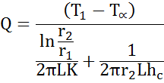
Critical radius of insulation for cylinder
T₁ > T₂ > T ∝
Ambient temperature(T∝)
T₂
r₁
h_{c}
T₁
Q =h_{c} 2Π r₂L (T₂ - T_{c})
r₂
r₂

Slide 12
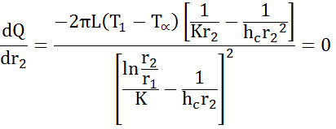
Critical radius of insulation for cylinder
Q
which gives the result
r
r₂
r_{critical}
r_{crossover}
Above equation expresses the critical-radius-of-insulation concept. If the outer radius is less than the value given by this equation, then the heat transfer will be increased by adding more insulation. For outer radii greater than the critical value an increase in insulation thickness will cause a decrease in heat transfer. The central concept is that for sufficiently small values of h the convection heat loss may actually increase with the addition of insulation because of increased surface area.

Slide 13
Thank you

