Slide 1
FLUID MECHANICS and HEAT TRANSFER (FMHT)
L. E. College, Morbi-2
Industrial Engineering Department
Chapter-07– Conduction
Prepared by Prof. Divyesh B. Patel
Mechanical Engg. Dept
LE. College, Morbi
+919925282644
divyesh21dragon@gmail.com

Slide 2
Heat Transfer
Heat always moves from a hot (warmer) place to a cold (cooler) place.
Hot objects in a cooler room will cool to room temperature.
Cold objects in a warmer room will heat up to room temperature.

Slide 3
Question
If a cup of coffee and a ice were left on the table in the room what would happen to them? Why?
The cup of coffee will cool until it reaches room temperature. The ice will melt and then the water will warm to room temperature.

Slide 4
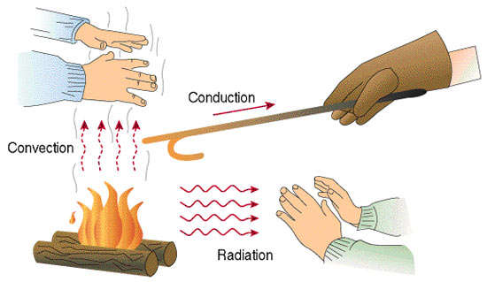
How is Heat Transferred?
There are THREE ways heat can move.
Conduction
Convection
Radiation

Slide 5
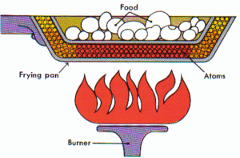
Conduction
Heat is transferred from one particle of matter to another in an object without the movement of the object.
Conduction = CONTACT

Slide 6
Conduction
When you heat a metal strip at one end, the heat travels to the other end.
As you heat the metal, the particles vibrate, these vibrations make the adjacent particles vibrate, and so on and so on, the vibrations are passed along the metal and so is the heat. We call this?
Conduction

Slide 7
Why does metal feel colder than wood, if they are both at the same temperature?
Metal is a conductor, wood is an insulator. Metal conducts the heat away from your hands. Wood does not conduct the heat away from your hands as well as the metal, so the wood feels warmer than the metal.

Slide 8
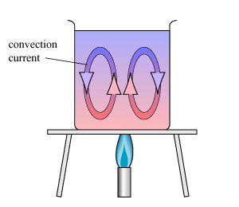
Convection
Convection is the movement that transfers heat within fluids and air (gas) Heat is transferred by currents within the fluid or gas
Convection = VENTS (through air and liquid particles)
Convection moves in a circular pattern

Slide 9
Convection
What happens to the particles in a liquid or a gas when you heat them?
The particles spread out and become less dense.
This effects fluid movement.
What is a fluid?
A liquid or gas.

Slide 10
RADIATION
Radiation is the transfer of energy by electromagnetic waves
Radiation does NOT require matter to transfer thermal energy
Radiation = Radiates (heat escaping the sun)

Slide 11
Radiation May Come From Other Sources
Have you ever sat too close to a campfire while cooking marshmallows? You’re enjoying the warmth ….. only to notice that your skin is really warm?

Slide 12
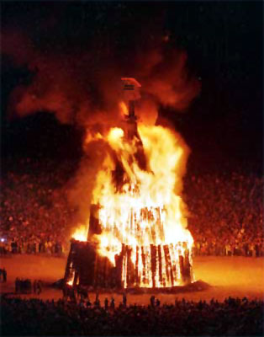
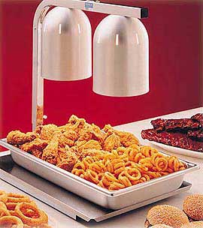
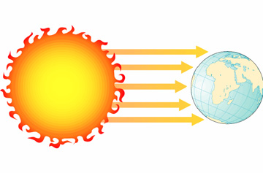
Examples of RADIATION
Fire
Heat Lamps
Sun

Slide 13
Thank you

