Slide 1
Automation in Manufacturing
Actuators

Slide 2
What is an actuator?
Actuators are devices used to produce action or motion.
Input(mainly electrical signal , air, fluids)Electrical signal can be low power or high power.
Actuators output can be position or rate i.e. linear displacement or velocity.
Actuation can be from few microns to few meters

Slide 3
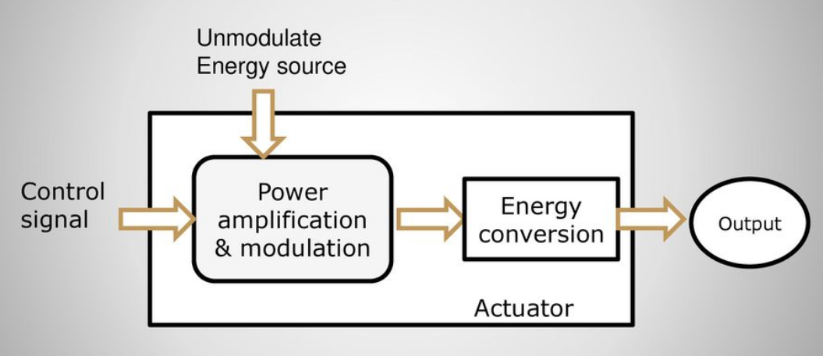
Actuator functional diagram

Slide 4
Types of actuators
Hydraulic actuator
Pneumatic actuator
Mechanical actuator
Electrical actuator
Linear actuator: solenoid, Hydraulic/Pneumatic
Rotary actuator: motor, Hydraulic/Pneumatic

Slide 5
Solenoid
A solenoid is a coil wound into a tightly packed helix
In physics, the term solenoid refers to a long, thin loop of wire, and wrapped around a metallic core.
Which produces a magnetic field when an electric current is passed through it.

Slide 6
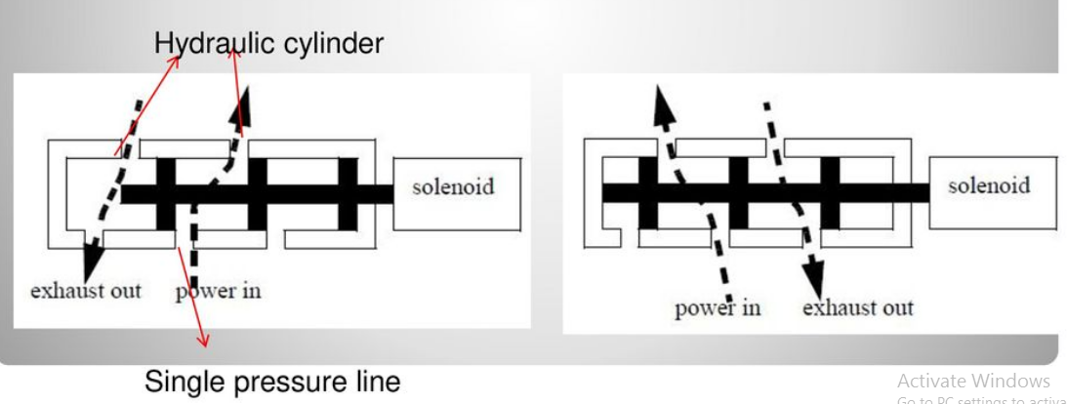
Application
Pneumatic valve
Car door openers

Slide 7
Types of hydraulic actuator
Hydraulic systems are used to control & transmit power. A pump driven by prime mover (electric motor) creates flow of fluid
Types of hydraulic actuator
Linear actuator (hydraulic cylinder)
Provides motion in straight line
Linear displacement depends on stroke length
Usually referred to as cylinders, rams (single acting cylinders)or jacks.
Rotary actuators (Hydraulic motors)
Produces continuous rotational motion
Pump shaft is rotated to generate flow
A motor shaft is caused to rotate by fluid being forced into the driving chambers

Slide 8
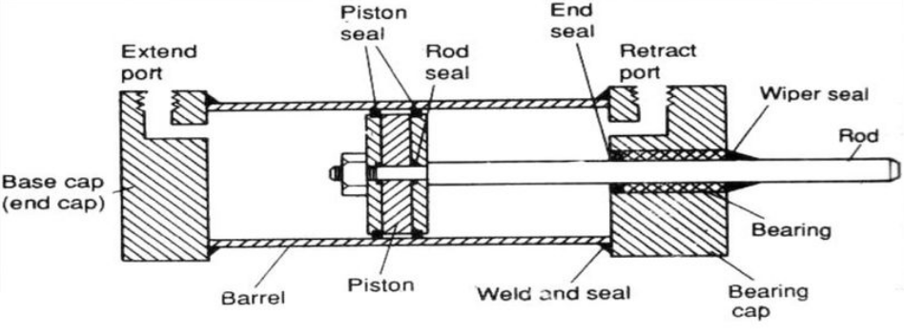
Pneumatic actuator
It convert energy formed by compressed air at high pressure into ether linear or rotary motion
Quickly respond in operation.

