Slide 1
Introduction To Heat Transfer
Prepared by:
Prof.Reena Makadia
Department Of Mechanical Engineering,
L.E.COLLEGE,MORBI

Slide 2
Thermodynamics
Thermodynamics
Amount
Heat Transfer
Rate
Energy Interaction
Mode

Slide 3
Thermodynamics
Amount
Heat Transfer
Rate
Energy Interaction

Slide 5
Content
Introduction
Heat Conduction
Heat Convection
Thermal radiation
Boiling And Condensation
Heat Exchangers

Slide 6
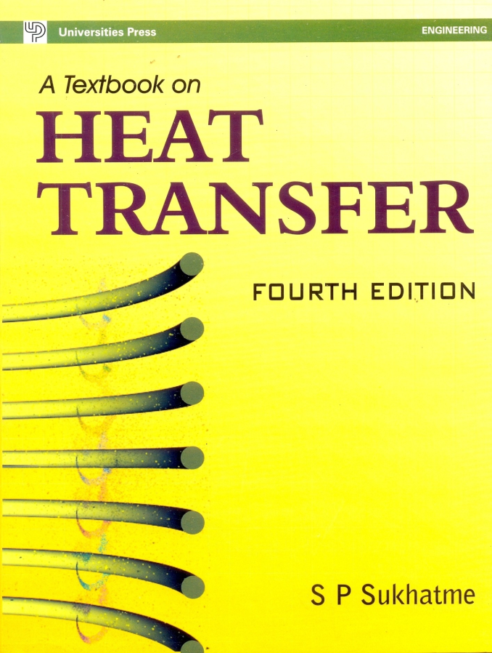
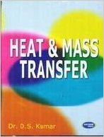
Books…

Slide 7
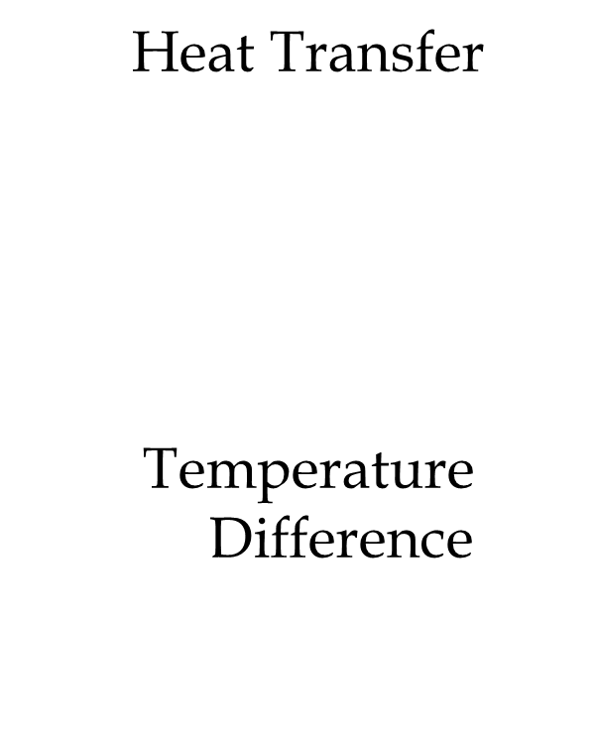
Introduction
What does the Heat Transfer subject deal with?

Slide 8
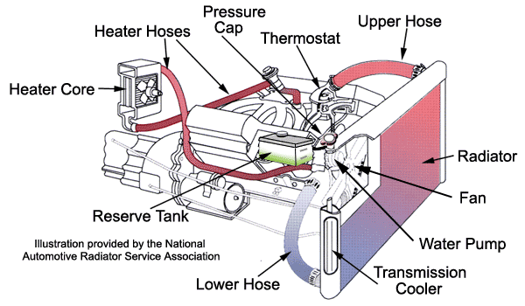

Slide 9
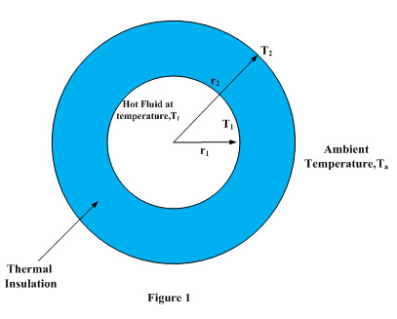
Heat Loss Through Thermal Insulation on a steam pipe

Slide 10
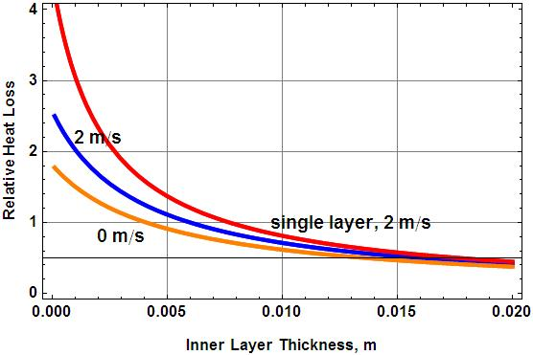

Slide 11
Heat Transfer to water Flowing through a Tube

Slide 12
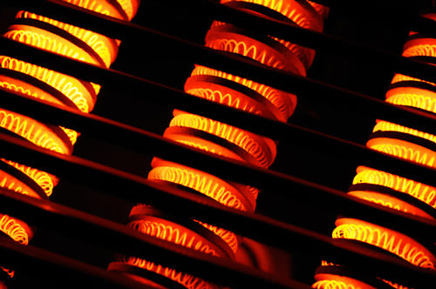
Heat Transfer In Electric Furnace

Slide 13
Three Modes Of Heat Transfer

Slide 14
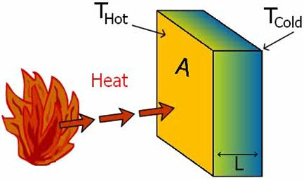
Conduction
Transport of energy in a medium due to a temperature gradient
Video

Slide 15
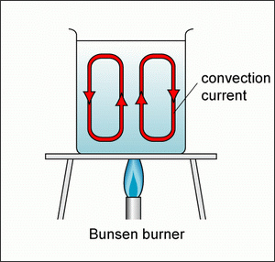
Convection
Energy transfer by fluid motion and random motion of fluid molecules(Conduction)
Video

Slide 16
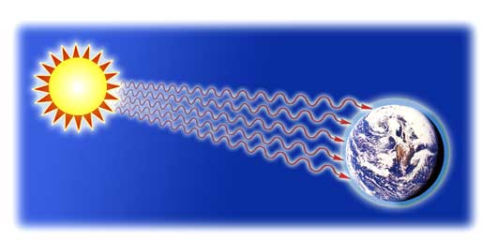
Video

Slide 17
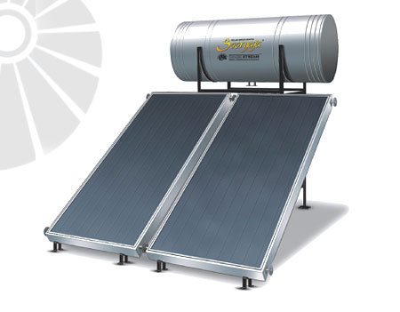
Flat Plate Solar Water Heater

Slide 18
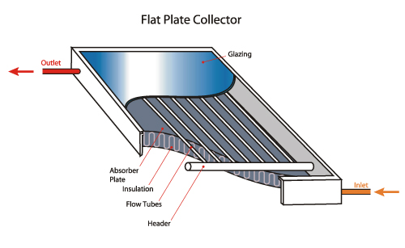

Slide 19
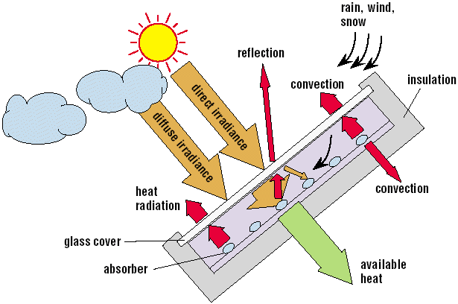

Slide 20
Thank You

Slide 21
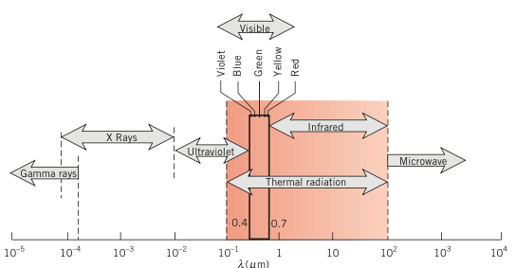
Spectrum of Electromagnetic Radiation

Slide 22
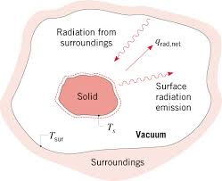
Thermal Radiation

Slide 23
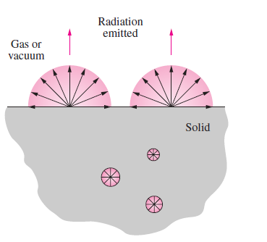
Surface Phenomenon

Slide 24
Assumptions
Vacuum between surfaces which exchange heat by radiation
If there is gas or air between surfaces which exchange heat by radiation ,this gas or air will not participate in heat exchange process.

Slide 25
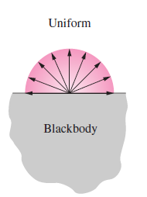
Emission Characteristics of Surfaces
Black Surface:
An ideal surface which absorbs all radiation falling on it regardless of its wavelength and direction
Its Emits maximum amount of energy

Slide 26
Emission Characteristics of Surfaces
Total Hemispherical Emissive Power (e):
Radiant flux emitted from a surface of a body(W/m²)
Total Hemispherical Emissive Power of a black surface is denoted by e_{b}
Total Hemispherical Emissivity(ε)

Slide 27
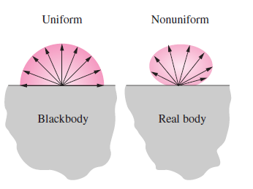
Total Hemispherical Emissivity(ε)

Slide 28
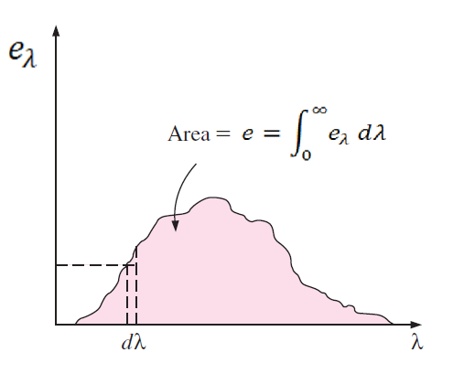
Monochromatic (Spectral)Hemispherical
Emissive Power (e_{λ})
Radiant flux emitted by unit wavelength, W/m²⁻μm
Or

Slide 29
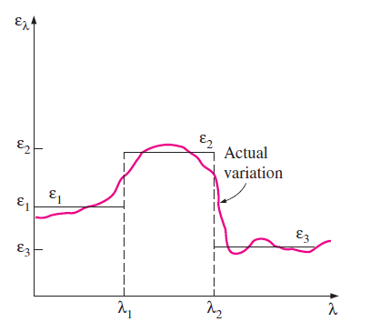
Monochromatic (Spectral)Hemispherical
Emissivity (ε_{λ})

Slide 30
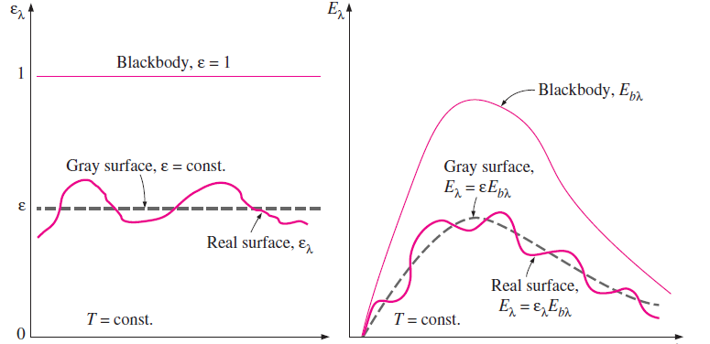
Grey Surface

